Slide 1
Welcome to Year 6
2025-2026

Slide 2

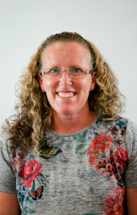
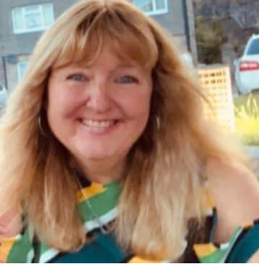
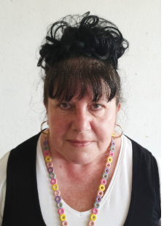
CLASSROOM STAFF IN YEAR 6
MISS JENNINGS
Class Teacher
MRS LEWIS - TA
MISS COOMBES- TA

Slide 3

CORE VALUES AT MORICE TOWN

Slide 4
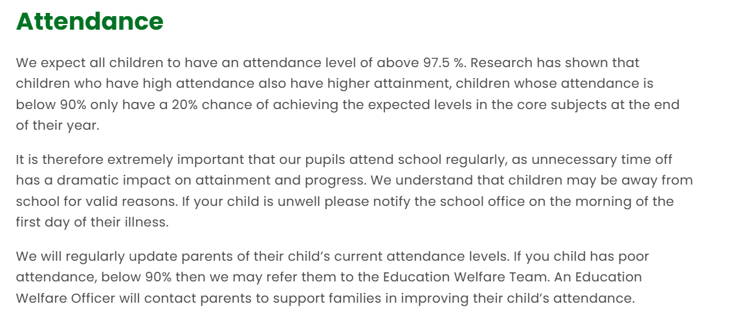
CORE VALUES AT MORICE TOWN
Notes:
If your child is late to school and they miss some of their learning, this will have to be completed in their own time (break/lunchtime) If they need support an adult will be available.

Slide 5
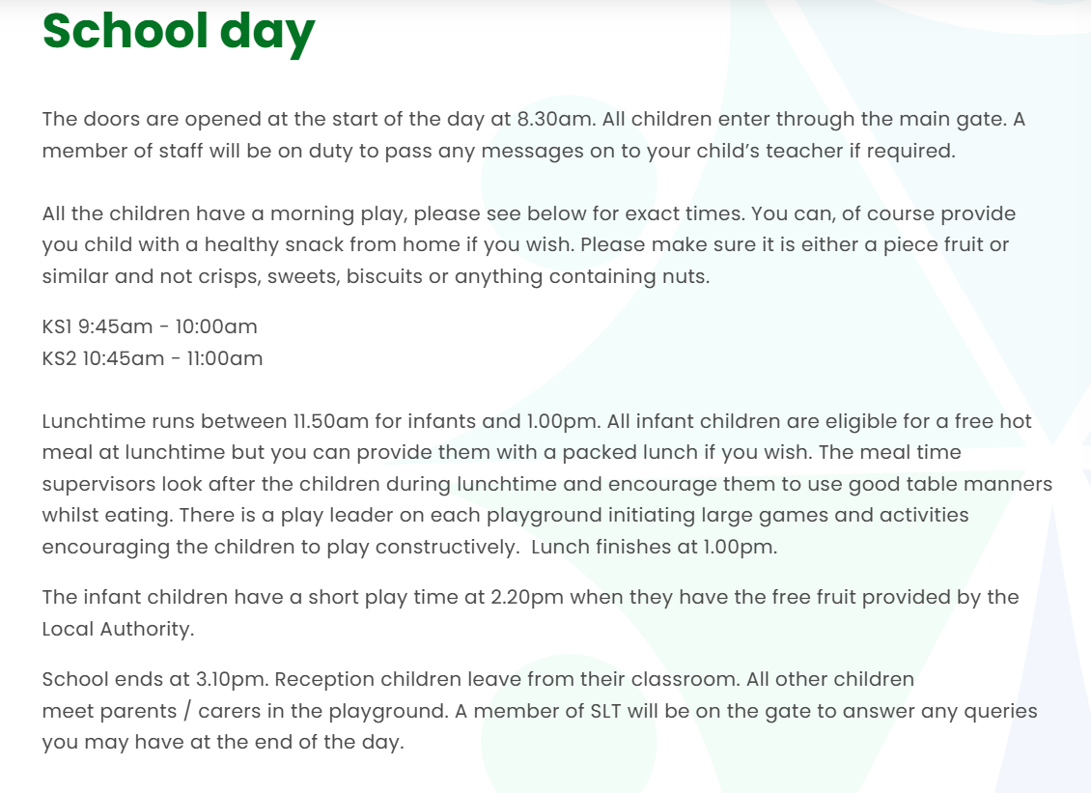
PACKED LUNCH BOXES AND DRINKS BOTTLES WILL BE KEPT OUTSIDE OF THE CLASSROOM ON THE BOOKSHELF.

Slide 6
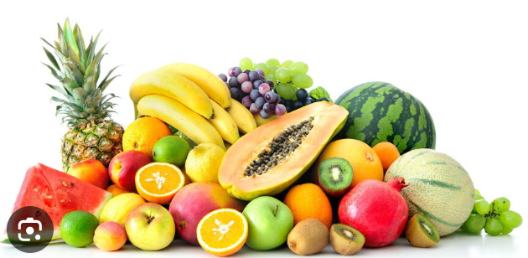

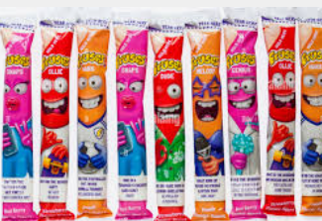


HEALTHY SCHOOL SNACKS
Ideas for a healthy snack:
Fruit.
Peppers/cucumber/carrot sticks
Cheese/cheese strings.
Yoghurt.
Cream crackers.
WE ARE A NUT FREE SCHOOL!
.
Notes:
Crisps/biscuits can be eaten by children during their lunchtime slot in the dining hall.

Slide 7
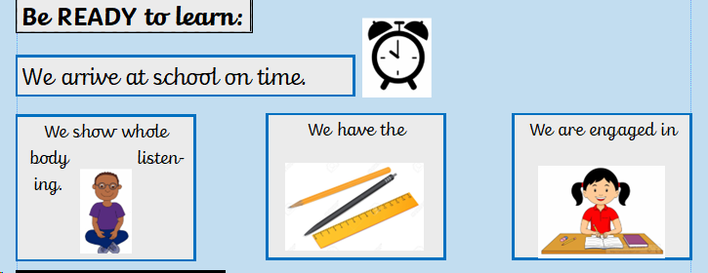
CLASSROOM RULES IN YEAR 6
Notes:
Children do not need to bring in any equipment from home,we will ensure they have what they need in their own pencil pots – they have responsibility of the belongings in their pot

Slide 8
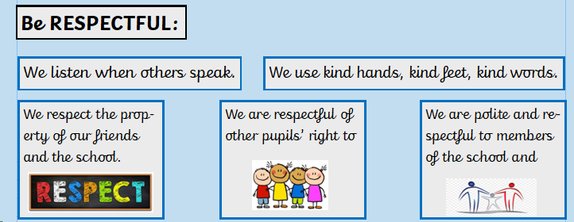
CLASSROOM RULES IN YEAR 6

Slide 9
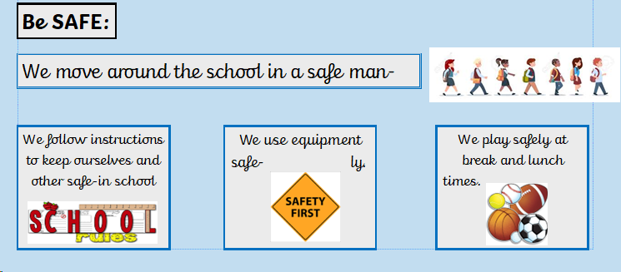
CLASSROOM RULES IN YEAR 6

Slide 10
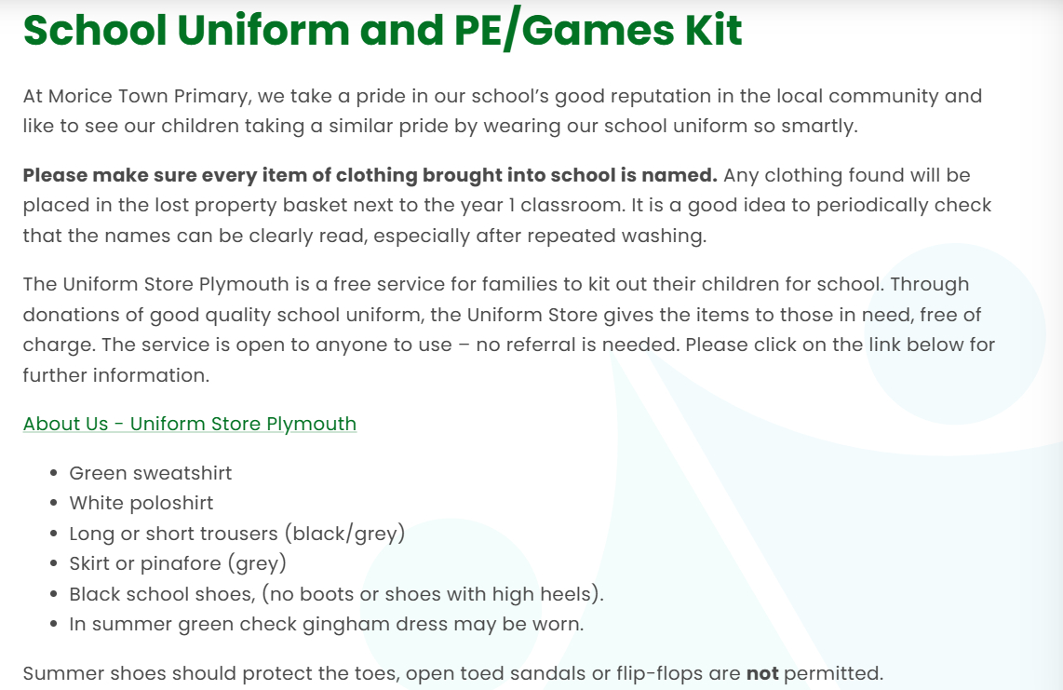
SCHOOL UNIFORM
Black/grey leggings may be worn for PE but are not school uniform.
Notes:
If children wear hoodies etc to school – they will be asked to removed them when they are in the classroom and hang them on their pegs.

Slide 11
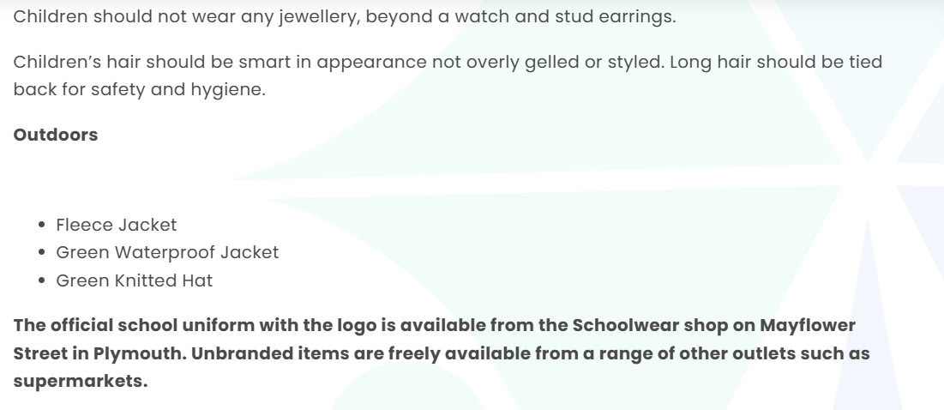
Please remember to bring a coat on wet or windy days.

Slide 12
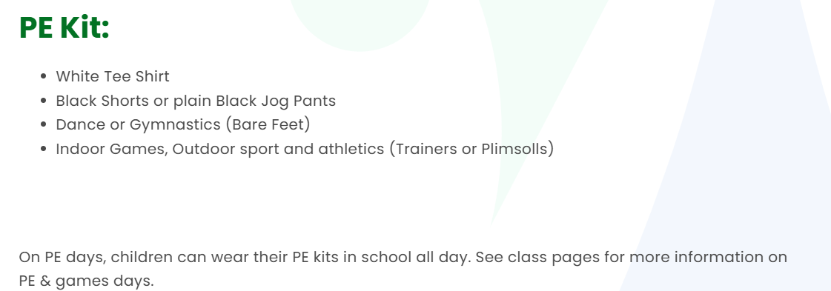
Black/grey leggings may be worn for PE but are not school uniform.
PE days will be on a Tuesday and Thursday.
NO HOODIES – SCHOOL JUMPERS/FLEECES/CARDIGANS.

Slide 13
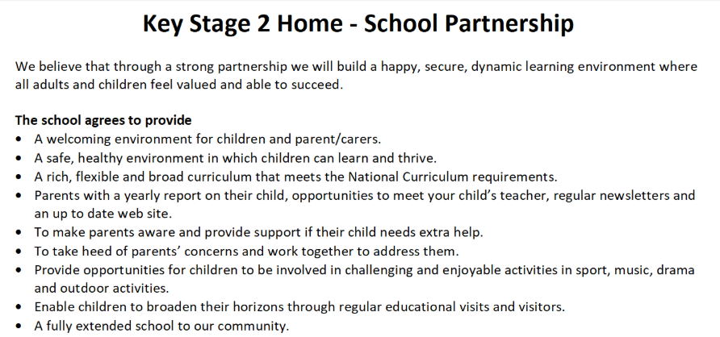
KEY STAGE 2 HOME-SCHOOL PARTNERSHIP

Slide 14
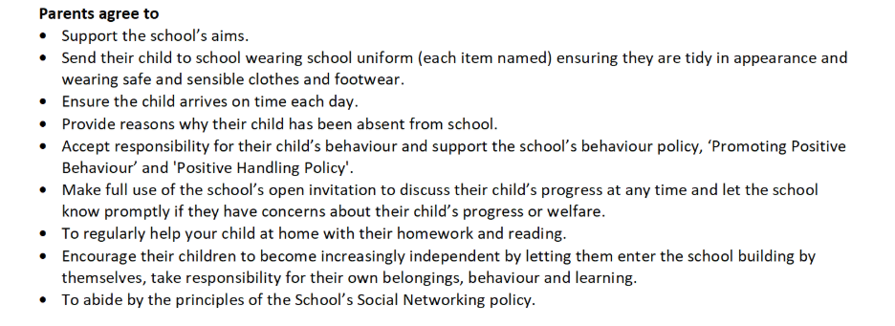

Slide 15
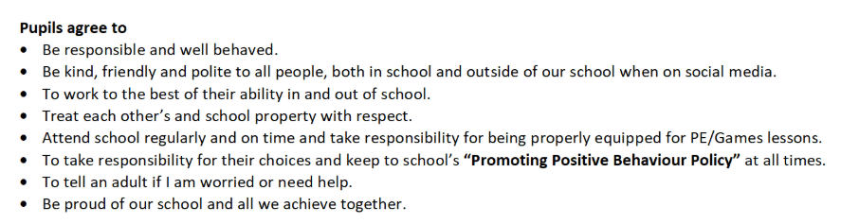

Slide 16
YEAR 6 SATS
SATS TAKE PLACE IN MAY.
SATs are Standard Assessment Tests taken by primary school pupils in England in Year 2 (KS1) and Year 6 (KS2) to measure their educational progress.. The tests are administered by the Standards & Testing Agency (STA), these national curriculum tests gauge a child's achievement against national standards in reading, grammar, punctuation, spelling, and mathematics. Results are used by parents and teachers to identify strengths and weaknesses, by schools for accountability, and by secondary schools to help assess children's starting points.

Slide 17
YEAR 6 HOMEWORK
Children are expected to read at home at least 3 times a week.
Children will have weekly spellings to practise at home for their weekly spelling test.
Children may be given further homework to complete : for example, Spelling and Grammar, maths, timetables.
Notes:
The children that read at home last year did exceptionally well in their SATS and found them less stressful.

Slide 18
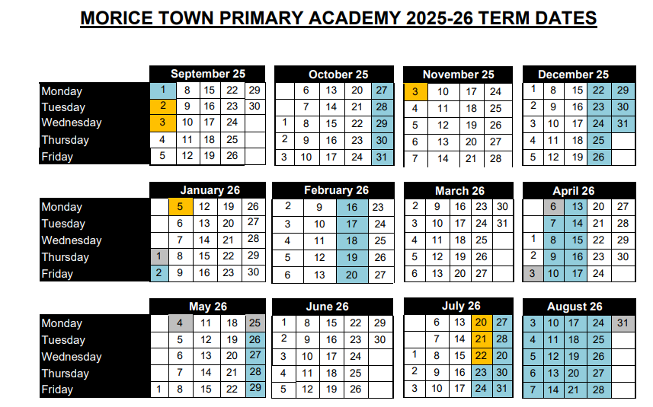
TERM DATES
.

